Slide 1

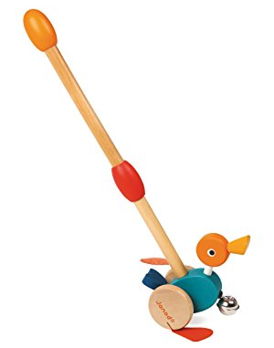
Duck N’ Roll Push Along Toy
Toy Name
Duck N’ Roll Push Along Toy
Manufacturer
Janod
Age
12 – 24 months
Parts
Push and Pull Duck Toy (Parts need to be assembled)
Develop Skills
Fine Motor
Imagination
Social
How it Works
Kaki kecil mainan bebek yang terbuat dari kulit sintetis akan bergerak-gerak dan belnya akan berbunyi ketika anak Anda mendorong mainan ini.
-
The little feet, made from synthetic leather, flap around and a large bell tinkles as your little one pushes the duck around.
How To Clean
Simply clean using a cloth that has been sprayed with non-toxic anti bacterial solution
Warning
Do not wash/soak in water
Store in a dry place
Keep out of direct sunlight

